Slide 1

Campaign Response Data Analysis
By Ankush Brella

Slide 2
Column Segmentation:
Customer
Organization
Salary
Balance
Loan
Housing Loan
Marital Status
Job
Education
Age
Loan Default
Duration
Contact Medium
Day
Month
P days
Campaign
Key column: Response

Slide 3
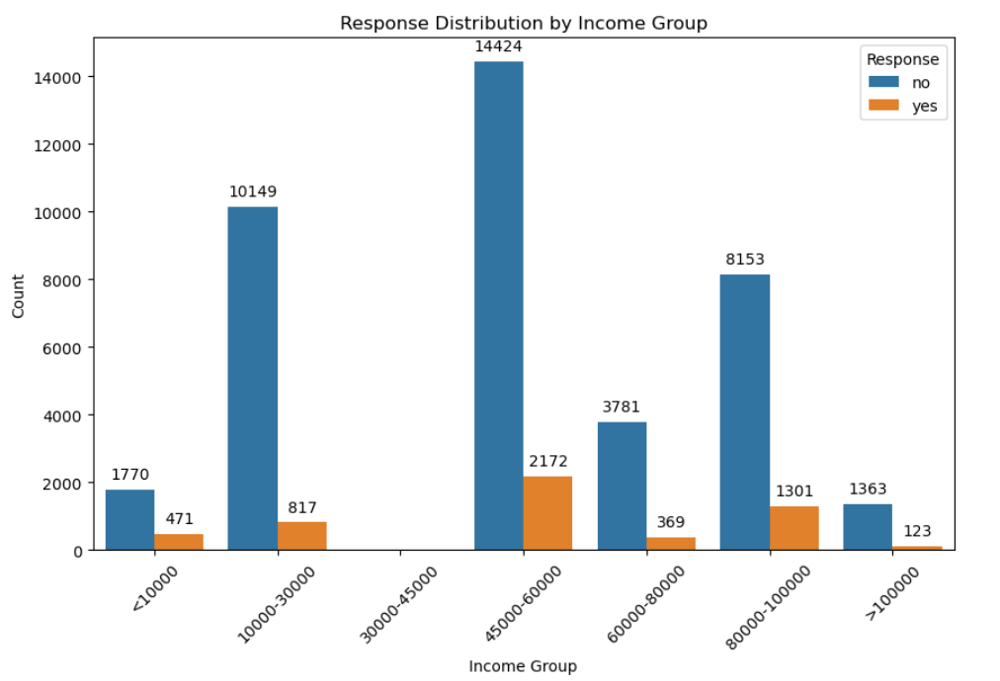
Response Distribution by Income Group:
Higher-income brackets, such as '45000-60000' and '>100000', display higher proportions of 'yes' responses, indicating greater campaign receptivity among affluent individuals.
Lower-income groups like '<10000' and '10000-30000' show lower 'yes' responses, suggesting potentially less receptivity to the campaign among individuals with lower incomes.

Slide 4
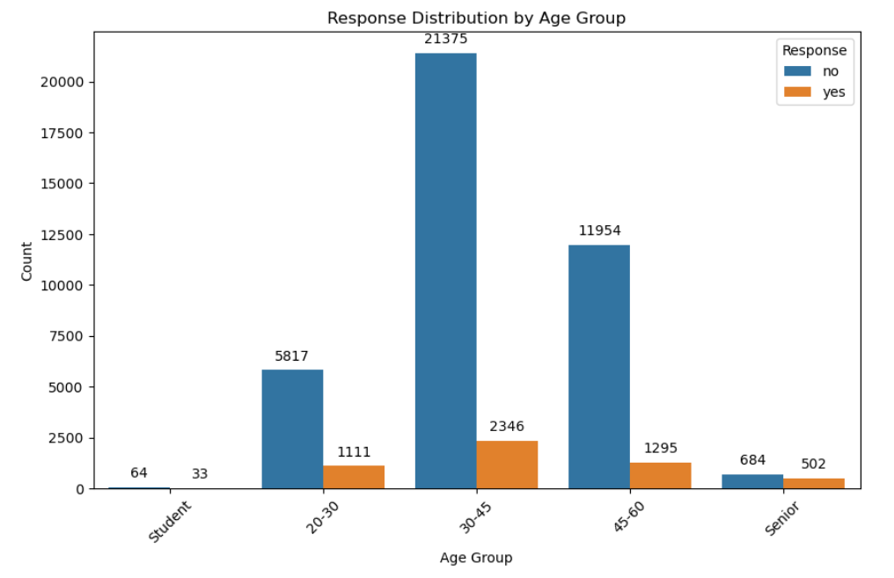
Response Distribution by Age Group:
Individuals aged 30-45 show the highest 'yes' responses, indicating strong campaign receptivity in this demographic.
'Student' and 'Senior' age groups exhibit higher 'yes' responses, suggesting greater campaign effectiveness among younger and older demographics.

Slide 5
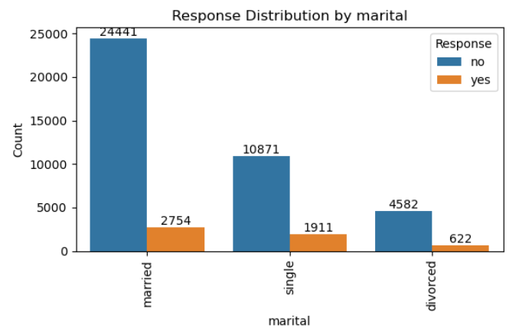
Response Distribution by Marital Status:
Married individuals show the highest count of 'yes' responses, while the single segment displays a higher 'yes' response proportion compared to 'no' responses.

Slide 6
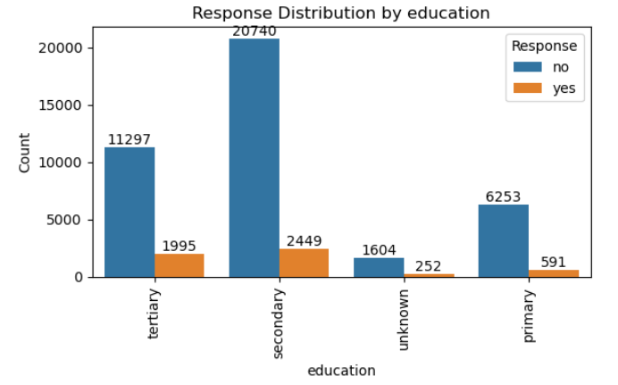
Response Distribution by Education:
The secondary education segment records the highest count of 'yes' responses, while the tertiary education segment exhibits a higher proportion of 'yes' responses compared to 'no' responses.

Slide 7
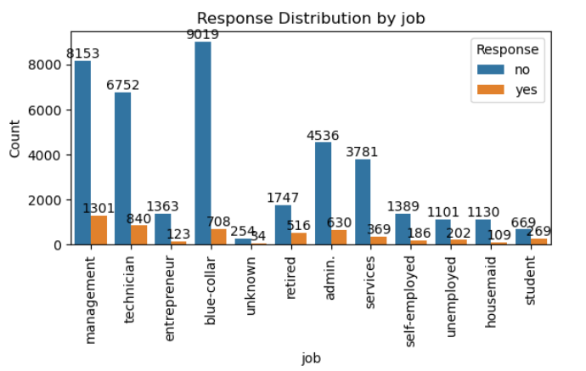
Response Distribution by Job:
The management segment demonstrates the highest count of 'yes' responses, whereas the student segment displays a higher proportion of 'yes' responses compared to 'no' responses.

Slide 8
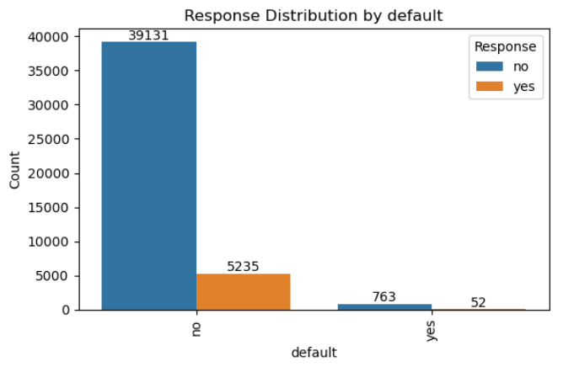
Response Distribution by Loan default:
Individuals with no history of loan defaults exhibit a higher rate of 'yes' responses compared to those with a history of defaults.

Slide 9
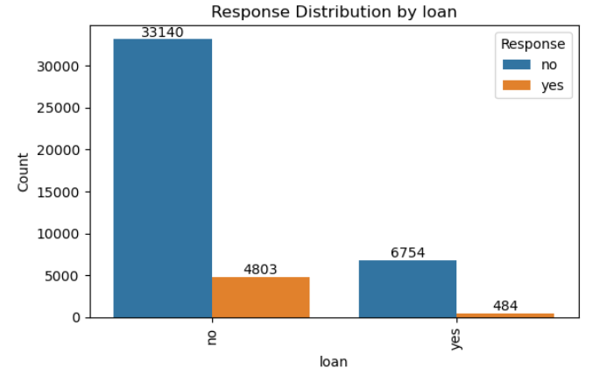
Response Distribution by Loan Status:
Individuals without any existing loans demonstrate a higher rate of 'yes' responses compared to those with loans.

Slide 10
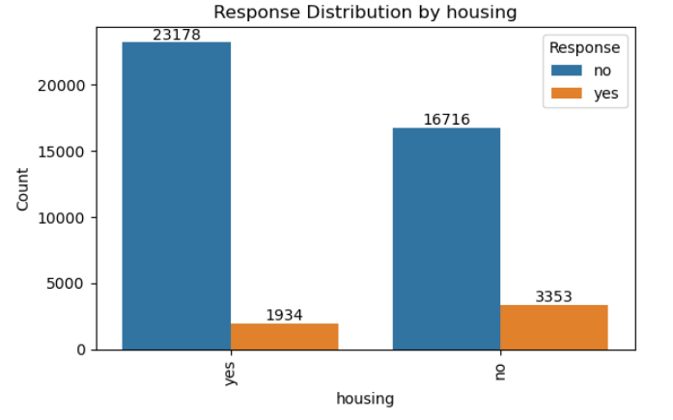
Response Distribution by Housing Loan Status:
Respondents without any existing housing loans exhibit a higher rate of 'yes' responses compared to those with housing loans.

Slide 11
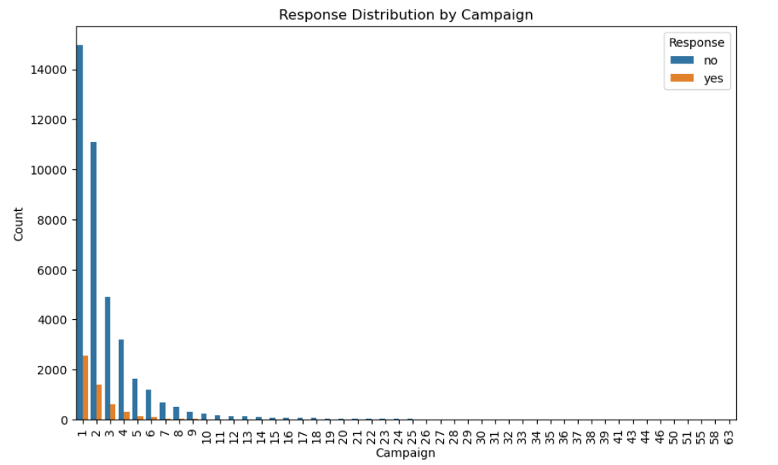
Campaign Effectiveness Analysis
The descending response rates across campaigns indicate that earlier campaigns were more effective than later ones.
This trend suggests potential improvements in strategies or targeting for subsequent campaigns to enhance effectiveness.

Slide 12
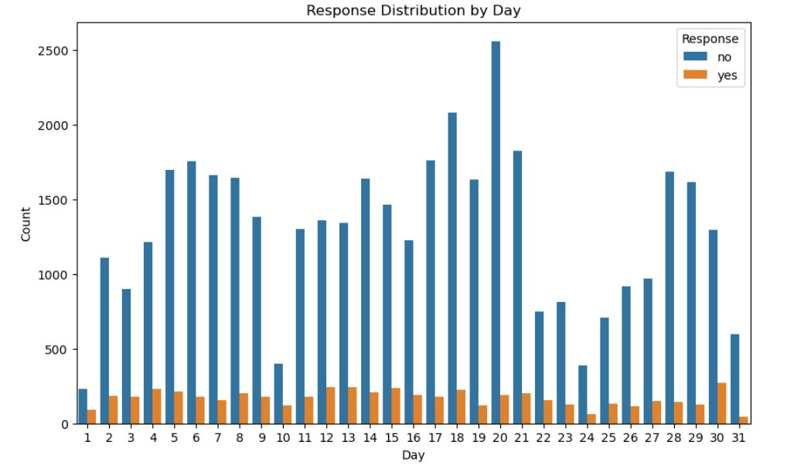
Seasonal Variations in Response Rates
Sine-like pattern suggests seasonal variations in response rates
Certain days or months may consistently show higher or lower response rates
Factors include holidays, weekends, and business cycles

Slide 13
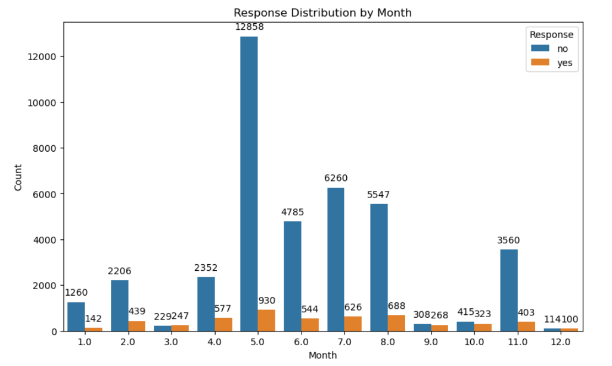
Response Distribution by Month
Majority of responses: May, June, July, and August (71.35%)
Best conversion months: March (51.89%), December (46.72%)
Lowest conversion: May (6.74%)

Slide 14
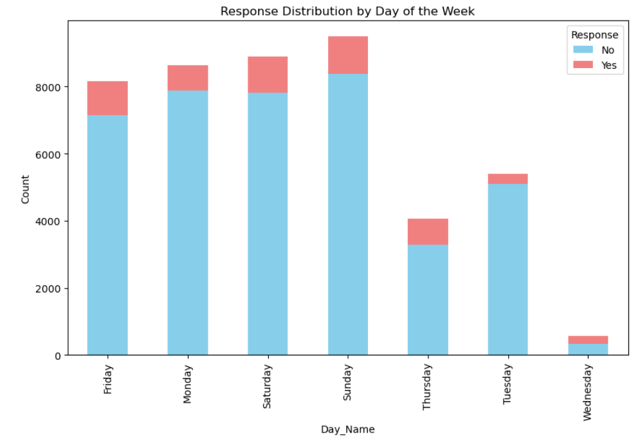
Weekend Effect and Response Behavior
Weekend Effect: More responses on weekends (Sat. & Sun.) likely due to increased leisure time, making people more receptive to marketing.
Start and End of Week: Mondays and Fridays may see higher responses as people return to work or catch up on communications.

Slide 15
THANK YOU

